Slide 1




Coffee sales analysis
2024-25
By Niloy Saha
page 01

Slide 2




About our company
BrewBeans Coffee Co. is a specialty coffee retailer of Ukraine known for premium blends and strong customer loyalty. Established in 2012, it runs café chains and online subscriptions, focusing on high-quality coffee and personalized experiences.
page 02

Slide 3

Our goals
  Customer purchasing preferences
  Types of payment
  Revenue from different payment
  Varieties of coffee and there prices
  Monthly customer count
  Monthly revenue
  Total revenue from different coffees
  Top selling coffee varieties
  Monthly sales of all coffee
page 03

Slide 4
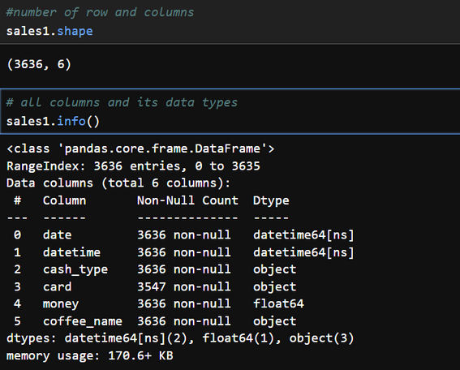
About the dataset
The dataset contains 3,636 rows and 6 columns, capturing coffee sales transactions for the entire year.
Columns are
  Date
  Datetime
  Cash Type
  Card
  Money
  Coffee Name
page 04

Slide 5
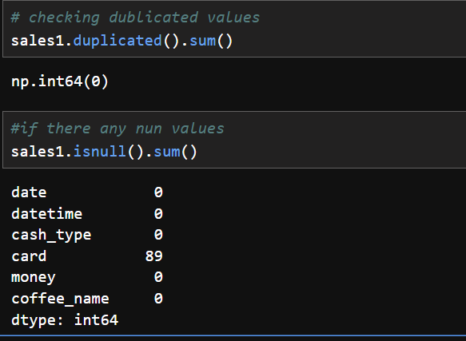
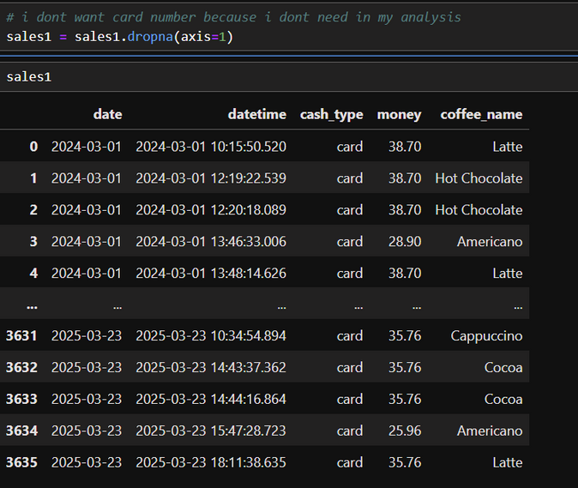
Data cleaning
  No duplicate records were found in the dataset.
  The dataset contains 89 missing values in the card column.
  The card column was dropped because it does not contribute to the analysis
page 05

Slide 6
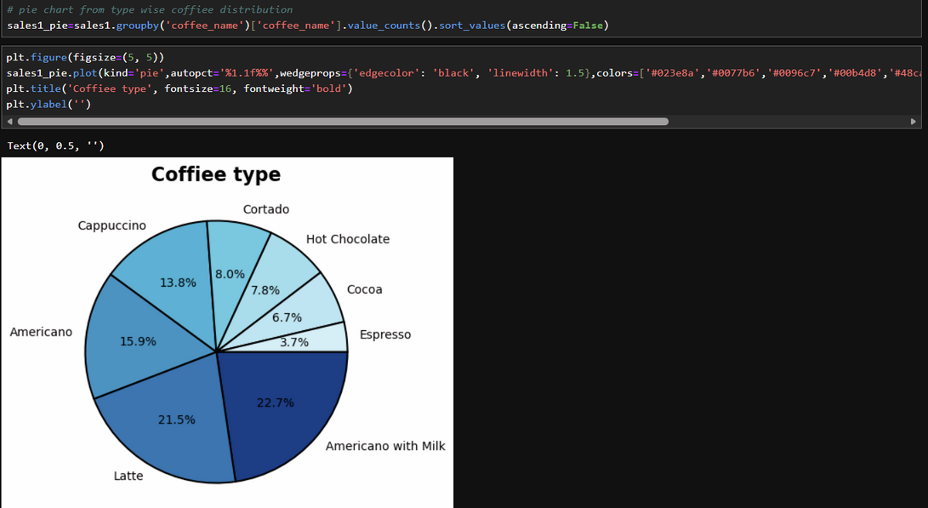
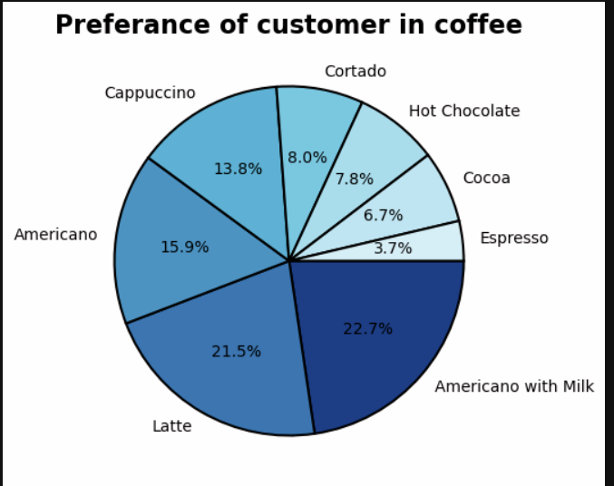
Customer purchasing preferences
Code used
Insights
  Americano with Milk is the most preferred drink (22.7%)
  Latte is the second most popular choice (21.5%)
  Americano ranks third in customer preference (15.9%)
  Together these three drinks make up 60%+ of customer choices
page 06

Slide 7
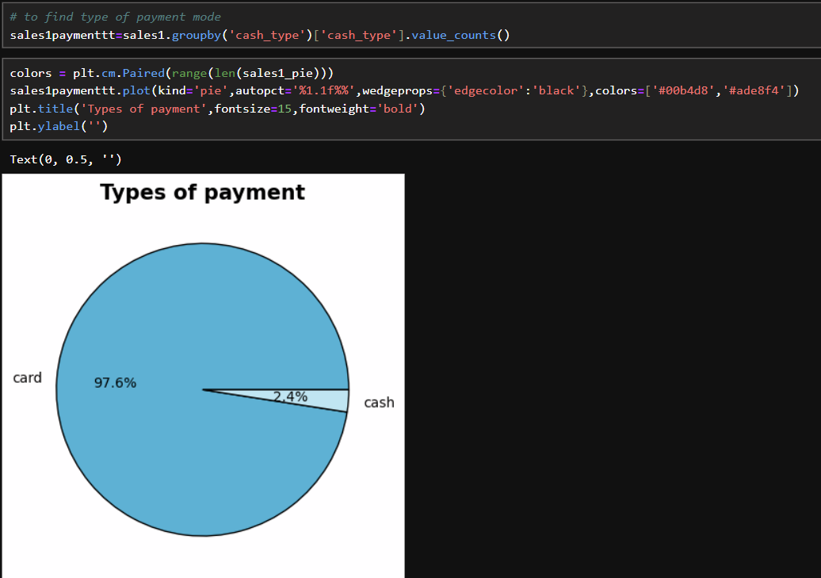
Types of payment
Code used
Insights
  In our shops 97.6% of customers use card for payment
  Only 2.4% of them use cash
page 07

Slide 8
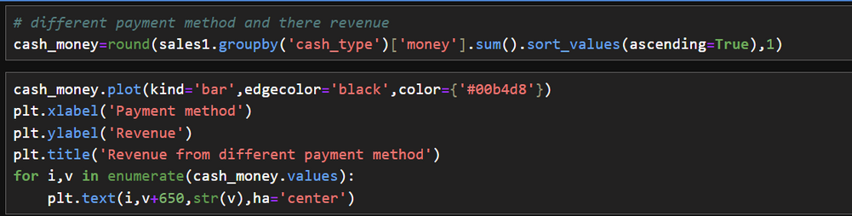
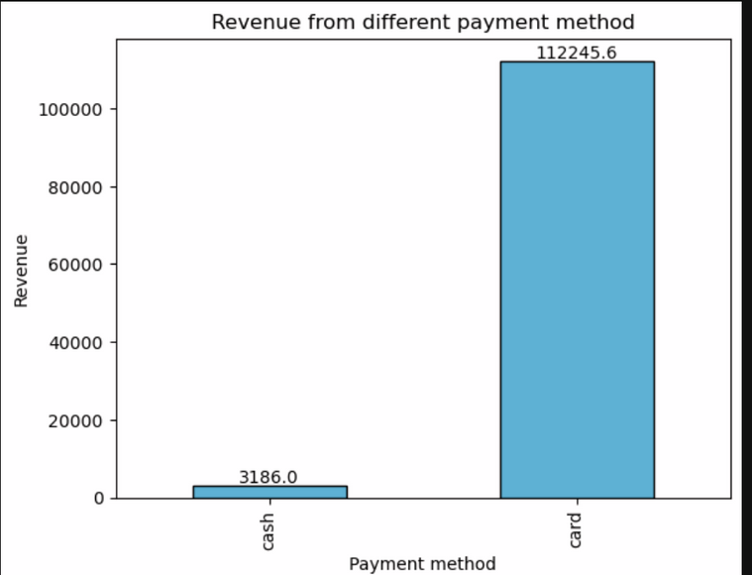
Revenue from different payment method
Code used
Insights
  Payment made by card is 112245 ₴
  Payment made by cash 3186 ₴
page 08

Slide 9
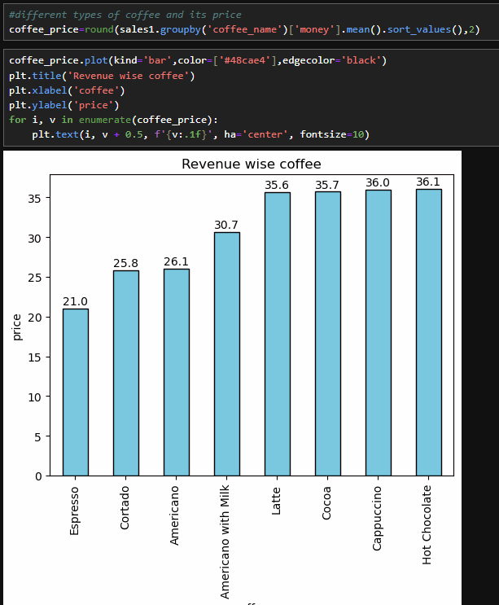
Varieties of Coffee and Their Prices
Code used
Insights
  Latte, Cocoa, Cappuccino, and Hot Chocolate are the most expensive options.
  Americanos fall into the moderate pricing category.
  Espresso is the least expensive of all coffee varieties.
  Customers tend to favor milk-based and sweeter drinks rather than stronger coffees.
page 09

Slide 10
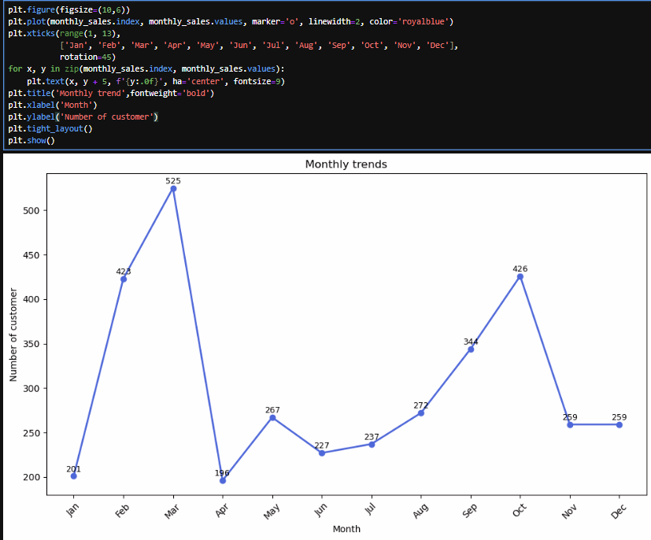
Monthly Customer Count
Code used
Insights
  Peak sales occur in April, showing the highest customer demand.
  Sales drop sharply in May and stay low through July.
  A recovery begins in August, with sales rising again.
  October shows another strong increase in sales.
  Sales fall again in November, ending the year lower.
page 10

Slide 11
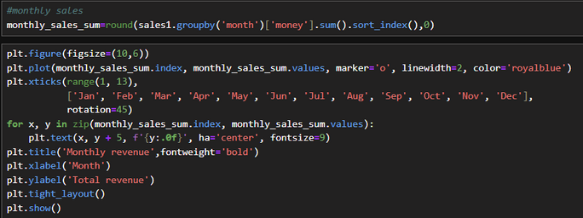
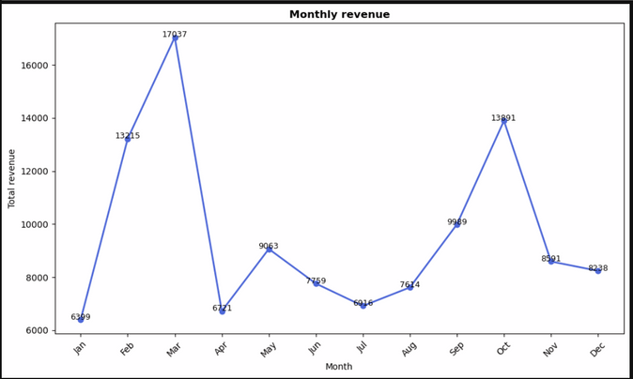
Monthly revenue trend
Code used
Insights
  March records the highest revenue.
  Revenue drops sharply in April.
  A small recovery happens in May.
  June–July shows a steady decline.
  Revenue starts rising again from August.
  October shows the second-highest peak.
  Revenue falls again in November and December.
page 11

Slide 12
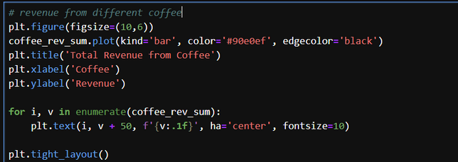
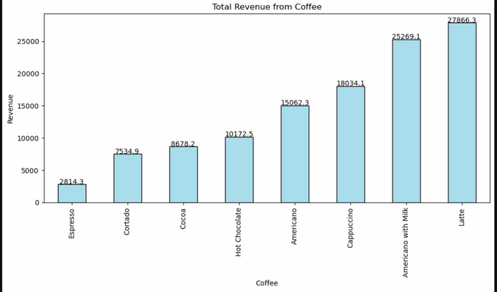
Total revenue from different coffee
Code used
Insights
  Latte leads in revenue.
  Americano with Milk ranks second.
  Cappuccino is a top three earner.
  Espresso has the lowest revenue.
  Milk and premium coffees outperform plain ones.
  Mid-level earners include Americano, Hot Chocolate, Cocoa, and Cortado.
page 12

Slide 13
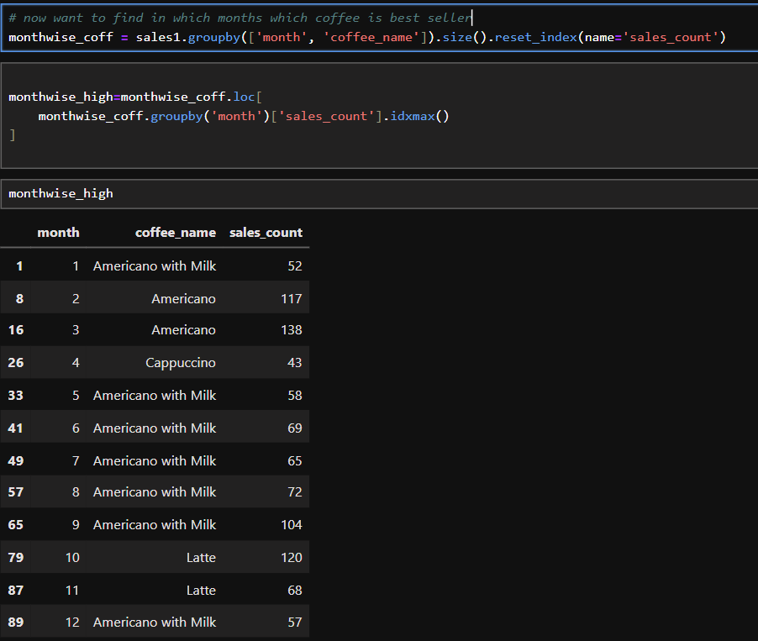
Top-Selling Coffee Varieties
Code used
Insights
  Peak sales occur in April, showing the highest customer demand.
  Sales drop sharply in May and stay low through July.
  A recovery begins in August, with sales rising again.
  October shows another strong increase in sales.
  Sales fall again in November, ending the year lower.
page 13

Slide 14
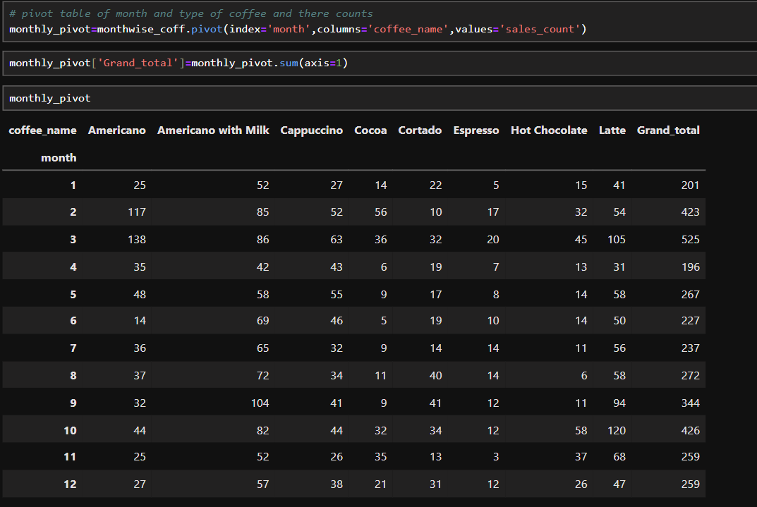
Monthly Sales of all coffee
Code used
Insights
page 14

Slide 15
Strategies to enhance sales
  Premium coffees like Cocoa, Cappuccino , Hot Chocolate are underperforming. So we should start offer campaigns with combos, tasting samples and loyalty.
  Slightly reducing prices or introducing smaller cup sizes can help premium coffees become more attractive to price-sensitive customers.
  Pair top-selling drinks like Latte with slow-selling items to encourage trials and increase total bill value.
  Americano with Milk, Americano ,Latte are customers favourite. So we should make some combos that can attract more customers.
page 15

Slide 16
  In the month of April, May, June, July there is sharp decline of customer visit, so we should start campaign in social media, SMS promotions, and café posters to maintain customers. In the high traffic months we should push some extra discounts and combos and launch premium bundles to increase per-customer revenue.
  We can see that most number of months sales of Americano with Milk and Latte is most so we should think about to increase the price of this coffees to get maximum profit,
page 16

Slide 17
Thank you for your time and attention.
I appreciate the opportunity to present this analysis.
nsaha3827@gmail.com
page 17

